Slide 1
Demo
by Arepalli MangaRao (AMR)

Slide 2
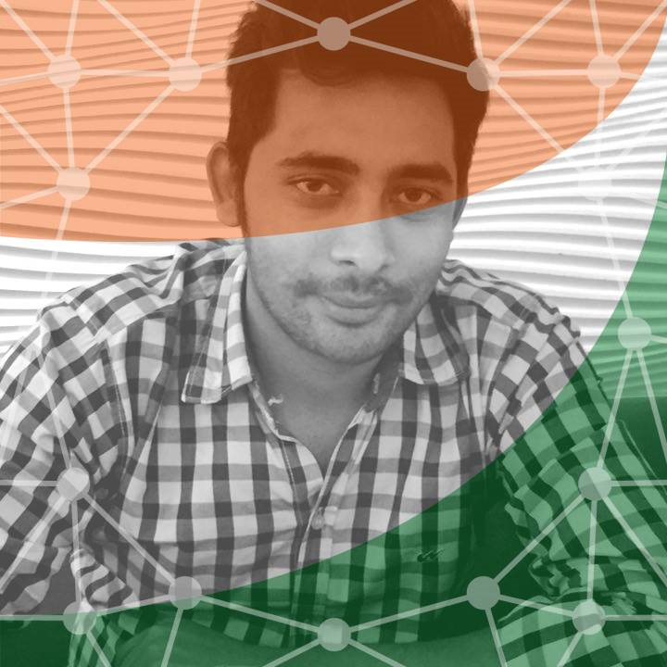
Introduction about Me
Name: MangaRao Arepalli
Working as a JAVA Developer and JAVA Trainer
Have 7+ years of development and training experience on JAVA technologies

Slide 3
Key Highlights of the training
All java concepts will be covered
Every program is typed, executed and explained
Hands on training
Improve Debugging skills
Assignments will be given daily
Doubts clarification daily
Java programs development using real-time tools
Coding As per real time standards
Console, GUI, and Web Applications development
Interview Questions and Answers discussion
Life time Doubts clarification even after course completion

Slide 4
Core java (duration : 25 working days)
Java basics (fundamentals)
OOPS
Exception Handling
Multi Threading
IO streams
Collections framework
Advanced concepts
Etc…

Slide 5
Advanced java (duration - 20 working days)
JDBC – 7 days
Servlets – 7 days
JSP – 5 days
Web Application development (using core java, servlets, jsp) – 1 day

Slide 6
Detailed Core and Advanced java syllabus

Slide 7
Core + Advanced JAVA duration (45 days)
JAVA SE(Core java, Advanced concepts, JDBC)
JAVA EE (Servlets, JSP, Expression Language, JSTL, Custom Tags)

Slide 8
Java Tools – (7 days)
1. Maven - Build tool
2. Log4j - logging tool
3. SVN - Version control tool
4. JUNIT - Unit Test framework
5. Jasper Reports - Reporting tool (iReport designer)
6. Find bug – code review tool - Code Review tool

Slide 9
Java Frameworks (duration – 45 days)
Struts
Spring
Hibernate…

Slide 10
JAVA Modules – by SUN MICROSYSTEMS
J2SE – Standard Edition - Learning JAVA Language and advanced concepts
J2EE – Enterprise Edition (Servlets, JSP, EJB, JNDI, JMS) to develop web and enterprise applications
J2ME – Micro or Mobile Edition – to develop mobile application

Slide 11
Why JAVA is more popular?
It is a platform independent
Java app will run on Windows, Linux(Fedora, Ubuntu, redhat, CentOS), Mac, etc..
It is WORA (Write Once Run Anywhere)
Using java we can develop the following applications
Desktop applications
Web ::
Enterprise ::
Distributed ::
Gaming ::
Animation ::
Embedded applications::
Mobile Applications ::
Etc….

Slide 12
Core java knowledge is mandatory for learning latest or some technologies are below
Android
Salesforce
Hadoop
Selenium
Hybris
Etc..

Slide 13
Java OPPORTUNITIES

Slide 14
Java opportunities We have multiple opportunities on java technologies.
1. Core Java Developer (J2SE)
2. Java/J2ee Developer (J2SE + J2EE)
3. Java-UI Developer (Java + web technologies (HTML+CSS+Javascript/JS frameworks(angular js))
4. Java-Android Developer (Java + Android)
5. Java Trainer/Faculty (Java)
6. Java Freelancer (Java)
7. Java Architect (Java expert)

Slide 15
Things to remember before starting programming
There is no rocket science in programming
Should know each and every word in the programming
Practice programs every day
Complete the assignments

Slide 16
To develop one web application, Knowledge on following technologies is added as an advantage
Web technologies: HTML, CSS, Java script (angular js , jquery, extjs, backbonejs)
Server side technologies: JAVA (servlets, jsp, EJB, Spring, Struts) , .Net(ASP), PHP
Db technologies: Oracle, Mysql, MS SQL SERVER
Server: Tomcat, Glassfish, Websphere – IBM, Weblogic server - Oracle

